Slide 1
The Problem
Build a machine Learning Model to predict the Duration of NYC Taxi Trip

Slide 2
Feature details
- id - a unique identifier for each trip
- vendor_id - a code indicating the provider associated with the trip record
- pickup_datetime - date and time when the meter was engaged
- dropoff_datetime - date and time when the meter was disengaged
- passenger_count - the number of passengers in the vehicle (driver entered value)
- pickup_longitude - the longitude where the meter was engaged
- pickup_latitude - the latitude where the meter was engaged
- dropoff_longitude - the longitude where the meter was disengaged
- dropoff_latitude - the latitude where the meter was disengaged
- store_and_fwd_flag - This flag indicates whether the trip record was held in vehicle memory before sending to the vendor because the vehicle did not have a connection to the server - Y=store and forward; N=not a store and forward trip.

Slide 3
Label details
trip_duration - duration of the trip in seconds

Slide 4
Passengers
New York City Taxi Passenger Limit says:
- A maximum of 4 passengers can ride in traditional cabs, there are also 5 passenger cabs that look more like minivans.
- A child under 7 is allowed to sit on a passenger's lap in the rear seat in addition to the passenger limit.
So, in total we can assume that maximum 6 passenger can board the new york taxi i.e. 5 adult + 1 minor

Slide 5
Exploring Data
We explored the data using the below lines of code :
Data.head( )
Data.shape
Data.isnull( ).sum( )
There is no NaN/NULL record in the dataset, So we don’t have to impute any record.

Slide 6
UniVAriate analysis
The analysis of one variable is called univariate analysis.
We plotted different plots as box plot, count plot, etc.
Plots are made on different columns namely passenger_count, vendor_id, distance, etc.
Different plots help us get a better understanding about the data.

Slide 7
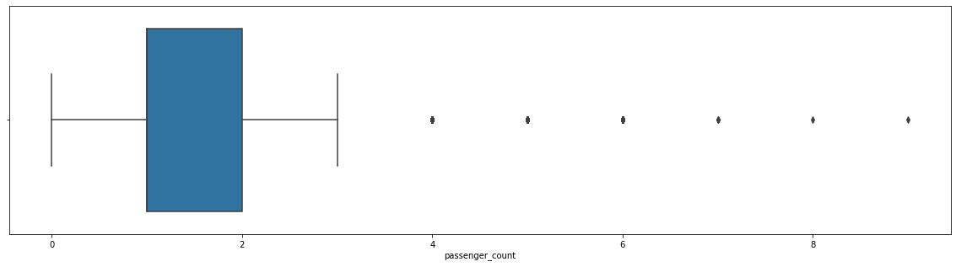
Plots
Fig: A box plot on passenger_count.

Slide 8
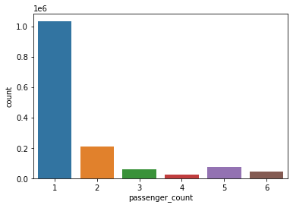
Plots
Fig: A count plot on passenger_count

Slide 9
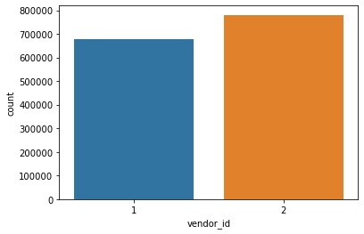
Plots
Fig: A count plot on vendor_id

Slide 10
Bivariate Analysis
Bivariate analysis is used to find out if there is a relationship between two sets of values.
It usually involves the variables X and Y.
We have plotted different point plots, bar plots, box plots, etc.
The plots are useful in finding trip duration per hour, week day , etc.
They are also useful in finding distance per hour, week day, etc.

Slide 11
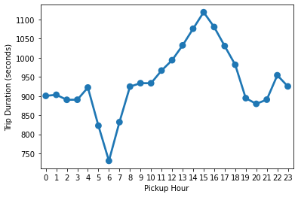
Plots
Fig : Trip duration per hour.

Slide 12
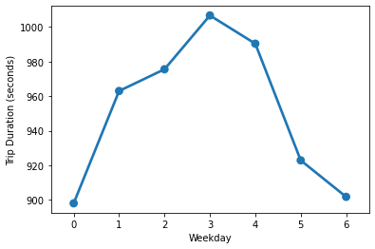
Plots
Fig: Trip duration per weekday

Slide 13
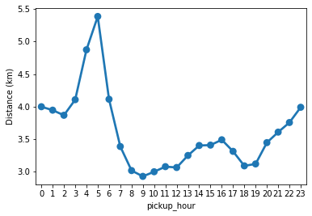
plots
Fig : Distance pe hour

Slide 14
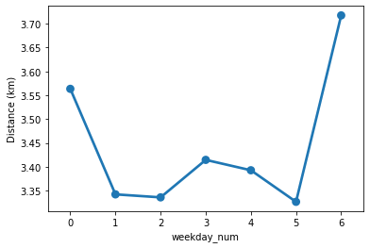
Plots
Fig : Distance per week day.

Slide 15
Splitting The data
#Split raw data
X_train, X_test, y_train, y_test = train_test_split(X,Y, random_state=4, test_size=0.2)
#Split data from the feature selection group
X_train_fs, X_test_fs, y_train_fs, y_test_fs = train_test_split(X_opt,Y, random_state=4, test_size=0.2)

Slide 16
Model Training
#Linear regressor for the raw data
regressor = LinearRegression()
regressor.fit(X_train,y_train)
#Linear regressor for the Feature selection group
regressor1 = LinearRegression()
regressor1.fit(X_train_fs,y_train_fs)

Slide 17
Model Training
#Linear regressor for the Feature extraction group
regressor2 = LinearRegression()
regressor2.fit(X_train_pca,y_train_pca)

Slide 18
Model Prediction
#Predict from the test features of raw data
y_pred = regressor.predict(X_test)
#Predict from the test features of Feature Selection group
y_pred = regressor1.predict(X_test_fs)
#Predict from the test features of Feature Extraction group
y_pred_pca = regressor2.predict(X_test_pca)

Slide 19
Model Evaluation
#Evaluate the regressor on the raw data
print('RMSE score for the Multiple LR raw is : {}'.format(np.sqrt(metrics.mean_squared_error(y_test,y_pred))))
print('Variance score for the Multiple LR raw is : %.2f' % regressor.score(X_test, y_test))
print("\n")

Slide 20
Model Evaluation
#Evaluate the regressor on the Feature selection group
print('RMSE score for the Multiple LR FS is : {}'.format(np.sqrt(metrics.mean_squared_error(y_test_fs,y_pred))))
print('Variance score for the Multiple LR FS is : %.2f' % regressor1.score(X_test_fs, y_test_fs))
print("\n")

Slide 21
End Notes
In this project we covered various aspects of the Machine learning development cycle. We observed that the data exploration and variable analysis is a very important aspect of the whole cycle and should be done for thorough understanding of the data. We also cleaned the data while exploring as there were some outliers which should be treated before feature engineering. Further we did feature engineering to filter and gather only the optimal features which are more significant and covered most of the variance in the dataset. Then finally we trained the models on the optimum featureset to get the results.

